Slide 1
DEPLOYMENT TO PRODUCTION

Slide 2
WHAT IS SHOPPING CART?
A shopping cart refers to a feature on an e-commerce website or application that allows users to select and store products for eventual purchase.
The shopping cart serves as a virtual container for products, enabling users to manage their purchases efficiently during an online shopping session.

Slide 3
WHAT IS JENKINS?
Jenkins is an open-source automation server widely used to automate various stages of software development, including build, test, and deployment.
Continuous Integration (CI): Automatically building and testing code whenever changes are committed.
Continuous Delivery/Deployment (CD): Automatically deploying new code to production or staging environments.

Slide 4
WHAT IS SONARQUBE?
SonarQube is an open-source platform used for continuous inspection of code quality.
It performs automatic analysis of code to detect issues related to bugs, vulnerabilities, code smells (maintainability issues), and duplication.

Slide 5
WHAT IS DOCKER?
Docker is an open-source platform designed to automate the deployment, scaling, and management of applications inside lightweight, portable containers.
A container is a lightweight, standalone, and executable software package that includes everything needed to run a piece of software: the application code, runtime, libraries, environment variables, and configuration files.

Slide 6
STEP 1:LAUNCH INSTANCE
Click on launch instance
Select AMI as ubuntu

Slide 7
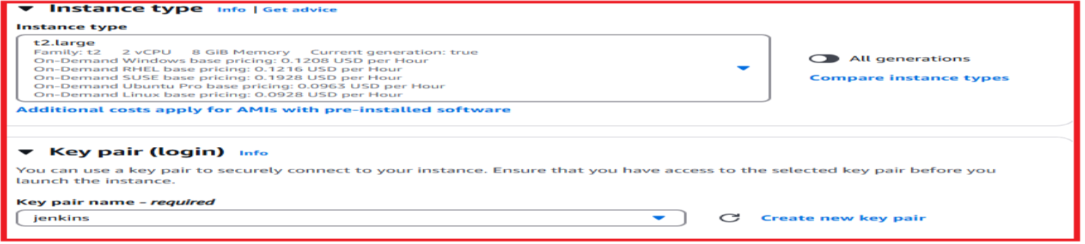
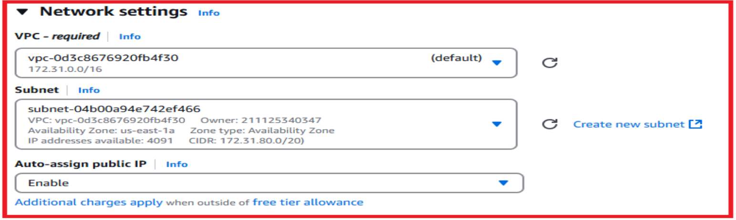
Select the instance type as t2.large
Select the network settings as VPC—Subnet—Auto-assign public IP

Slide 8
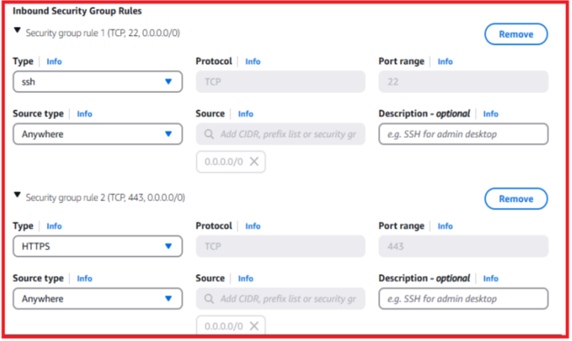
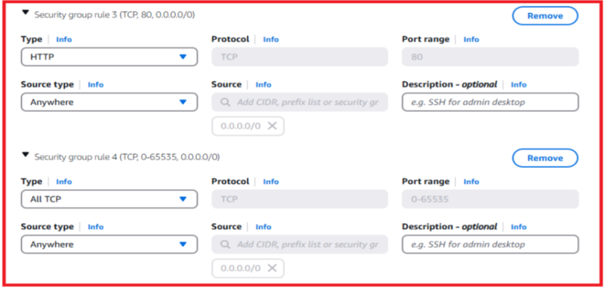
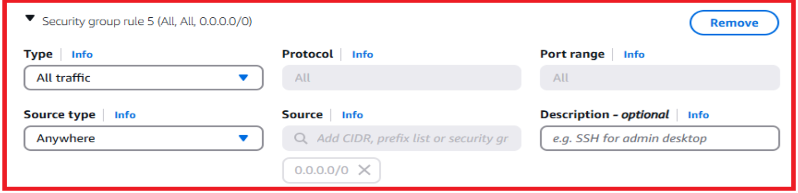
Edit inbound security group rules ssh-http-https-all tcp-all traffic-anywhere.

Slide 9
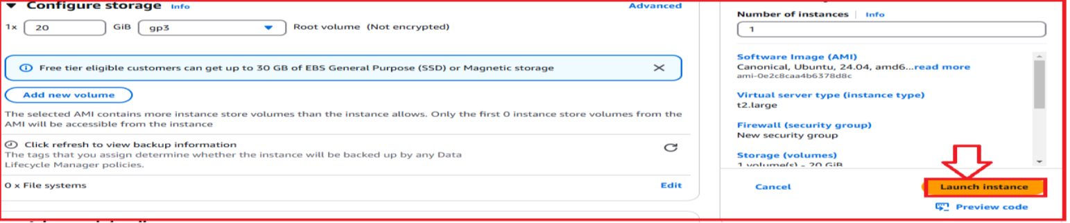
Configure storage and click on the launch instance
The below image shows that the instance is successfully launched.

Slide 10
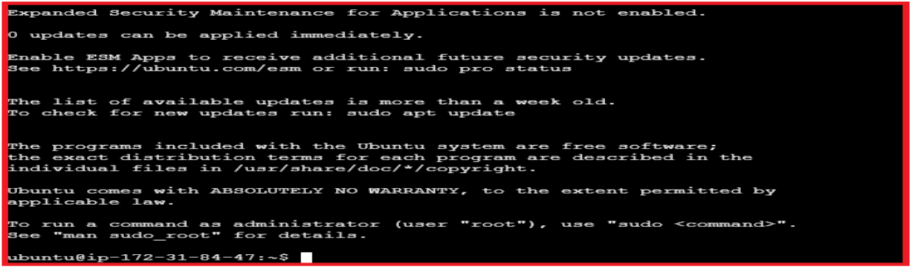
Connect the instance with .pem file or ec2 instance connect the below image shows that the instance is connected.

Slide 11
STEP 2:TO INSTALL JENKINS
sudo wget -O /usr/share/keyrings/jenkins-keyring.asc \
https://pkg.jenkins.io/debian-stable/jenkins.io-2023.key
echo "deb [signed-by=/usr/share/keyrings/jenkins-keyring.asc]" \
https://pkg.jenkins.io/debian-stable binary/ | sudo tee \
/etc/apt/sources.list.d/jenkins.list > /dev/null
sudo apt-get update
sudo apt install fontconfig openjdk-17-jre -y
sudo apt-get install jenkins -y
sudo systemctl start jenkins
sudo systemctl enable jenkins
sudo systemctl status jenkins

Slide 12
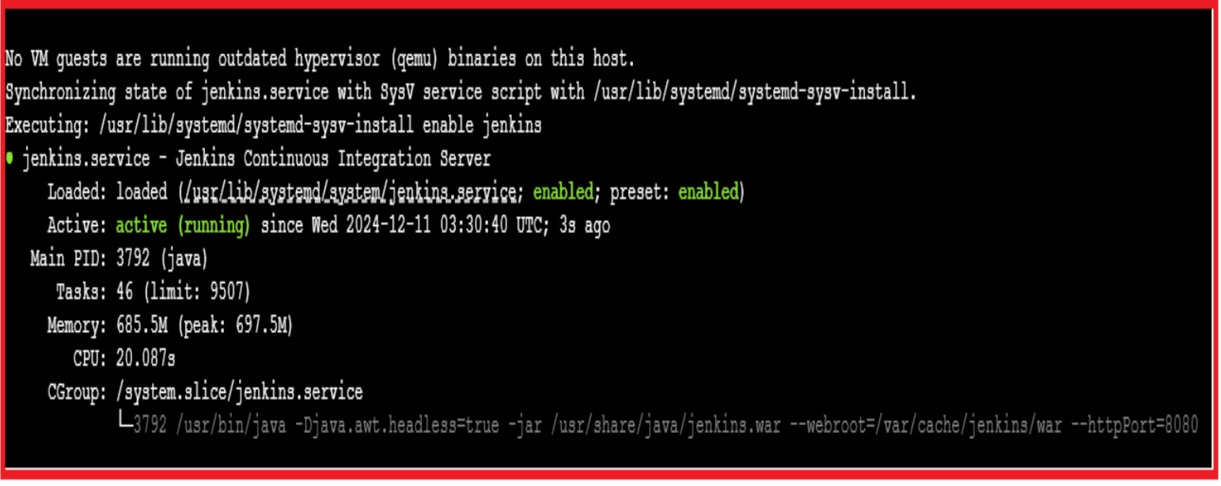
The below image shows that the Jenkins is active running.

Slide 13
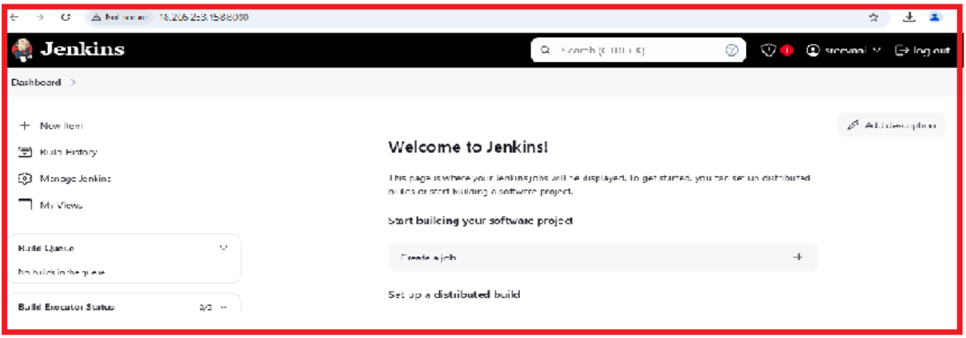
sudo apt install maven –y
mvn –versión
Copy the PUBLIC IP ADDRESS:8080 and paste it on new tab.
The below image shows that the unlock Jenkins is opened and Jenkins dashboard is opened.

Slide 14
sudo systemctl stop Jenkins
sudo systemctl status Jenkins
cd /etc/default
sudo vi Jenkins
Change the http _port no:8090

Slide 15
cd /lib/systemd/system
sudo vi jenkins.service
sudo systemctl daemon-reload
sudo systemctl restart Jenkins
sudo systemctl status Jenkins

Slide 16
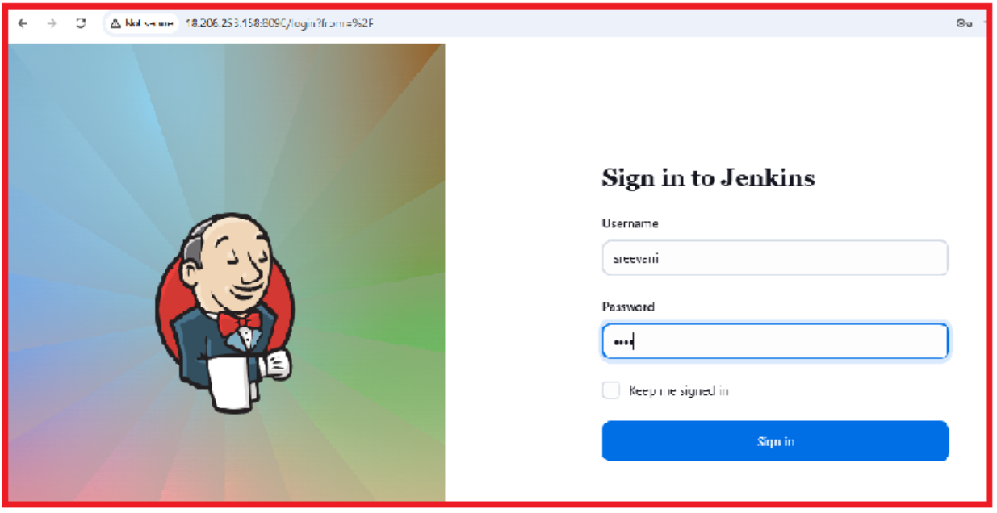
Copy the PUBLIC IP ADDRESS:8090 and paste it on new tab.
After changing the port no:8080—8090.the below images shows that the sign into Jenkins dashboard is opened and welcome to Jenkins is also opened.

Slide 17
STEP 3:INSTALL DOCKER
sudo apt-get update
sudo apt-get install docker.io -y
sudo usermod -aG docker $USER #my case is ubuntu
newgrp docker
docker run -d --name sonar -p 9000:9000 sonarqube:lts-community
Copy the instance of PUBLIC IP ADDRESS:9000 and paste it on new tab.
The below image shows that the SonarQube dashboard is opened.

Slide 18
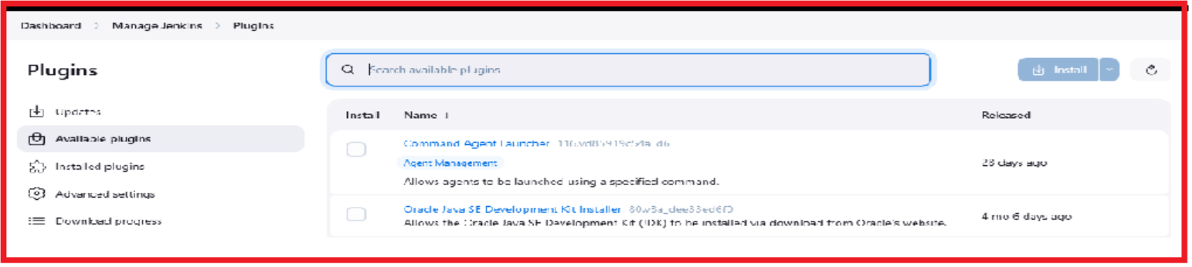
STEP 4:JENKINS DASHBOARD(8090)
In Jenkins dashboard click on the manage Jenkins.
In Manage Jenkins click on the plugins.
Plugins --Available plugins—sonar scanner—eclipse temurin installer—maven integration—pipeline stage view—docker commons
Above plugins we need to install.

Slide 19
Jenkins dashboard—manage Jenkins—Tools
The below images shows that the we need to add the tools like jdk,maven,git,docker,sonarqube scanner.

Slide 20
In SonarQube dashboard click on the administrator.
In administrator click on the security.
In security click on the users and we have to create sonar-token.
The below images shows that the sonar-token is successfully generated.

Slide 21
In SonarQube dashboard click on the administrator
In administrator click on the configuration
In configuration click on the webhook and we have to create webhook.

Slide 22
In Jenkins dashboard click on the manage Jenkins and select the credentials as secret text and add the sonar-token URL as secret and id as sonar-token and description as sonar-token and click on create.

Slide 23
In Jenkins dashboard click on the manage Jenkins and select the credentials as username with password
Add the Docker Hub login credentials and click on the create.

Slide 24
Here the below image shows that the credentials is added in our Jenkins dashboard –manage Jenkins—credentials.

Slide 25
In Jenkins dashboard click on manage Jenkins and select the system as SonarQube installations .
Here we are adding the sonar-server and http://localhost:9000
And server authentication token as sonar-token.

Slide 26
In Jenkins dashboard we have to create new item.
Enter an item name
Select the pipeline project and click on ok.

Slide 27
The below image shows that the pipeline script we are adding in configure and click on apply and save .
Go to build now and click on the build now .

Slide 28
The Pipeline stage view is as shown below image.

Slide 29
STEP 5:SONARQUBE DASHBOARD (BUGS)
In SonarQube dashboard we have to detect bugs in code.
We have 25 bugs in code and we are trying to resolve the bugs.
Click on the bugs and open the bugs and select the resolve to fix and the bug is resolved .the below images shows that the bugs has been resolved.

Slide 30
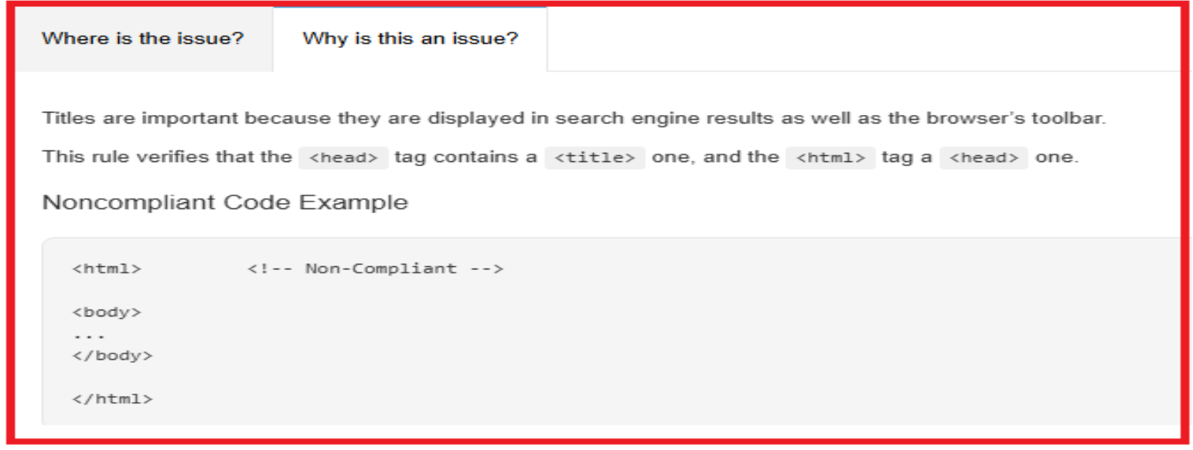
Where is the issue?
Why is this an issue?
When we are dealing with bugs in SonarQube, the issues can stem from a variety of factors related to the setup, configuration, or the code being analyzed.

Slide 31
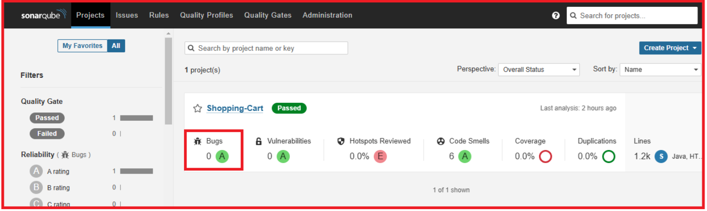
After resolving the bugs and refresh the SonarQube dashboard .
The below image shows that the bugs are 0 .

Slide 32
STEP 6:SHOPPING-CART
Copy the public ip address of your instance and paste it on new tab as ip address :8070
The below image shows that the shopping-cart login.
Username
password

Slide 33
Firstly we have register the shopping-cart .
The registration process will be like
First name
Last name
Gmail
Password
Username
Click on submit

Slide 34
Login to the shopping-cart as username and password .
The below image shows that the different number of products are available in shop and click on buy and the product is added to our buy list.

Slide 35
Here sreevani’s shopping-cart payment is shown below and click on the checkout the payment will be generated .

